Slide 1

Computer Graphics
Dr. Lucy J. Gudino
Computer Science & Information Systems Group
Birla Institute of Technology & Science, Pilani, Goa Campus
1

Slide 2
Video display devices
Cathode-ray tubes
Refresh and Raster-scan displays
Random-scan displays or Calligraphic displays
Color CRT displays
Flat-panel displays
Three-dimensional viewing devices
Stereoscopic and virtual-reality systems

Slide 3
CRT display devices
Invented by Karl Ferdinand Braun (1897)
A cathode ray tube or CRT is a specialized vacuum tube in which images are produced when an electron beam strikes a phosphorescent surface.
Phosphor emits photon of light, when hit by an electron – persistence
Refreshing – Refreshing rate to avoid flicker / trail
Phosphors are organic compounds characterized by their persistence and their color (blue, red, green).
Main components of the CRT : Electron gun, focusing and deflection system and Phosphor coated screen.

Slide 4
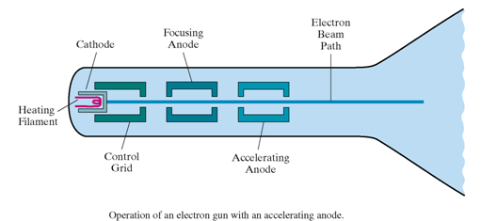
CRT display devices
Electron Gun
Cylindrical cathode
Filament
Control grid

Slide 5
CRT display devices
Control Grid:
Intensity of the electron beam is controlled
Is a metal cylinder and Negatively charged
high negative voltage reduces the electron density and thus brightness
Accelerating anode and focusing anode positively charged
Accelerating anode is used to provide acceleration
Focusing
Focusing forces the electron beam to converge to a point on the monitor screen
Can be electrostatic or magnetic

Slide 6
Contd…
Deflection system
Deflection directs the electron beam horizontally and/or vertically to any point on the screen
Can be controlled by
electric (deflection plates) field → electrostatic deflection system
magnetic fields (deflection coils) → electromagnetic deflection system
Magnetic coils: two pairs (top/bottom, left/right) of tube neck
Coils mounted on the outside of the CRT envelope
Electric plates: two pairs (horizontal, vertical)

Slide 7
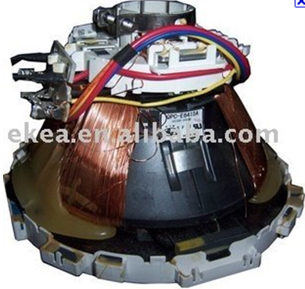
Magnetic Deflection System

Slide 8
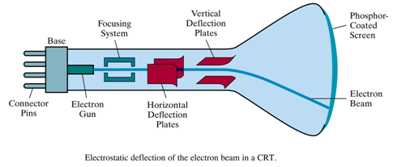
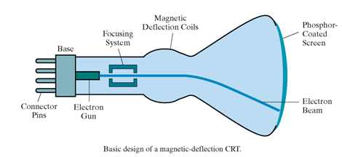
CRT display devices

Slide 9
Contd…
Examples
Electro-magnetic deflection system- TV
Electrostatic deflection -CRO
Persistence is defined as the time it takes the emitted light from the screen to decay to one-tenth of its original intensity.
Lower the persistence, higher the refresh rate
Low persistence – animation
High persistence – complex, static pictures
Resolution
Number of points per centimeter that can be displayed horizontally and vertically
High resolution system → High definition systems

Slide 10
Contd…
CGA: Color Graphics Array : 320 X 200
VGA – Video Graphics Array : 640 X 480
SVGA – Super VGA : 800 X 600
XGA – Extended Graphics Array: 1024 X 768
QVGA – Quarter VGA : 1280 X 960
SXGA - Super XGA : 1400 X 1050
UXGA – Ultra XGA : 1600 X 1200
QXGA – Quad XGA : 2048 X 1536
QSXGA – Quad SXGA : 2800 X 2100
QUXGA – Quad UXGA : 3200 X 2400

Slide 11
Contd…
Two adjacent spots will appear distinct as long as their separation is greater than the diameter at which each spot has an intensity of about 60% of that at the center of the spot
Resolution depends on
type of phosphor
the intensity to be displayed
focusing and deflection system

Slide 12
contd…
Aspect Ratio
The ratio of vertical points to horizontal points necessary to produce equal length in both directions on the screen
Sometimes it is stated in terms of the ratio of horizontal to vertical points
Ex: aspect ratio = 3/4
CRT is a point plotting device

Slide 13
Raster-scan Displays
Based on TV technology.
Is a point plotting device
Point on the screen – Pixel or Pel – Picture element
Entire screen is a matrix of pixels
Each pixel brightness can be controlled
The display primitives (lines, characters, shaded and patterned areas etc.) are stored in a frame buffer or refresh buffer containing the total screen area and where each memory location corresponds to a pixel.

Slide 14
Contd…
Refresh buffer can be visualized as a set of horizontal raster lines or a row of individual pixels
Each point is an addressable point in screen and memory
In a monochrome system, each bit is 1 or 0 for the corresponding pixel to be on or off (bitmap).
The display processor scans the frame buffer to turn electron beam on/off depending on if the bit is 1 or 0.
Example: resolution: 1024x1024
color info: 24 bits
frame buffer size : 3 Mega bytes

Slide 15
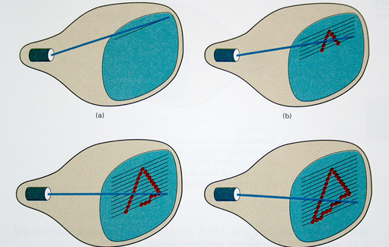
Raster-scan Displays

Slide 16
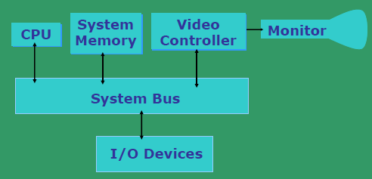
Architecture of a simple raster graphics system
Special purpose display processor

Slide 17
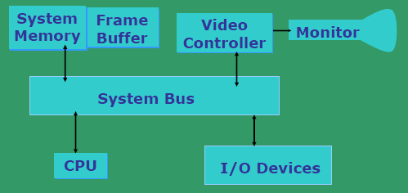
Architecture of a raster system with a fixed portion of the system memory reserved for the frame memory

Slide 18
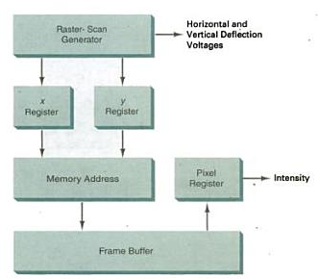

Slide 19
Contd…
For color monitors, the frame buffer also contains the color of each pixel (color buffer) as well as other characteristics of the image (brightness, …). 8 bits/pixel → 0..255 up to 24 bits/pixel
Line cannot be drawn directly from one point to another
‘aliasing’, ‘jaggies’ or ‘staircase’ effect
Refresh/Frame buffer is also called Bit-plane, Bitmap or pixmap

Slide 20
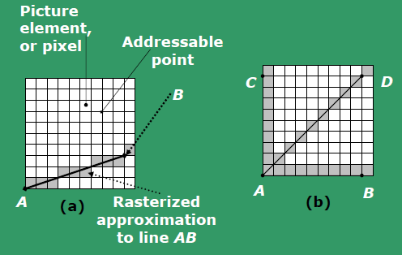
Raster-scan Displays

Slide 21
Raster-scan Displays
Refreshing is a must
Refresh rate: 24 is a minimum to avoid flicker, corresponding to 24 Hz (1 Hz = 1 frame per second)
Current raster-scan displays have a refresh rate of at least 60 frames (60 Hz) per second, up to 120 (120 Hz).
Uses large memory: 640x480 → 307200 bits → 38 kB
Refresh procedure:
Horizontal retrace – beam returns to left of screen
Vertical retrace – bean returns to top left corner of screen
Interlaced refresh – display first even-numbered lines, then odd-numbered lines permits to see the image in half the time useful for slow refresh rates (30 Hz shows as 60 Hz).
Reading Assignment : Interlaced refresh

Slide 22
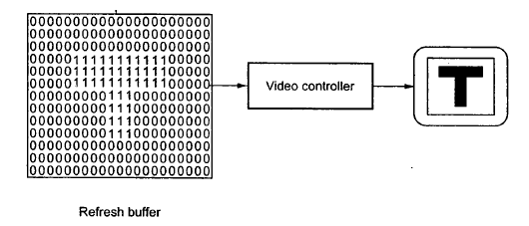
Frame Buffer Organization
Holds the set of intensity values for all the screen points

Slide 23
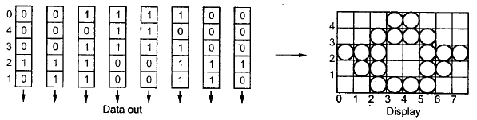
Frame Buffer Organization…
Implemented using shift register or RAM
Shift register – FIFO
No. of shift registers : no. of pixels on each scan line
Length of the shift register : number of scan lines

Slide 24
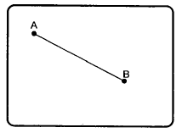
Random-scan Displays
draws a picture - one line at a time
Random scan systems are also called vector, line drawing, stroke-writing, or calligraphic displays.
The electron beam directly draws the picture in any specified order.
Vectored – electron beam is deflected from end-point to end-point
Information about magnitude and direction is required
Generated with the help of vector graphics generator
Notes:
electron beam directed only to the parts of the screen where a picture is
to be drawn

Slide 25
Random-scan Displays
Picture definition is stored as a set of line-drawing commands ➔ display list or program /refresh display file/ vector file
To display a specified picture, the system cycles through the set of commands in the display file
Order of deflection is dictated by the arbitrary order of the display commands
Phosphor has short persistence – decays in 10-100 micro sec
Display must be refreshed by scanning the list at least 30HZ (Max 60 Hz)
More suited for line-drawing applications such as architecture and manufacturing.

Slide 26
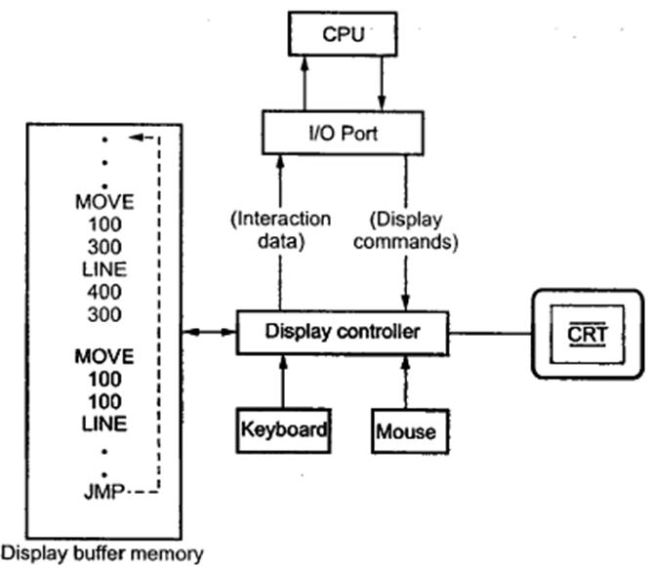
Random Scan Display Architecture
Vector generator: Converts the digital coordinate values to analog voltages for beam deflection

Slide 27
Contd…
Display or Refresh Buffer – memory space allocated to store the display list or display program for the display processor to draw the picture
The display processor interprets the commands in the refresh buffer for plotting
The display processor must cycle through the display list to refresh the phosphor
The display program has commands for point, line, and character plotting

Slide 28
Contd…
The display processor sends digital and point coordinate values to a vector generator
The vector generator converts the digital coordinate values to analog voltages for the beam-deflection circuits
The beam-deflection circuits displace the electron beam for writing on the CRT’s phosphor coating
Minimum refresh rate : 30 Hz. Recommended refresh rate is 40 – 50 Hz.
Scope for animation with segmentation – mixture of static and dynamic parts of a picture

Slide 29
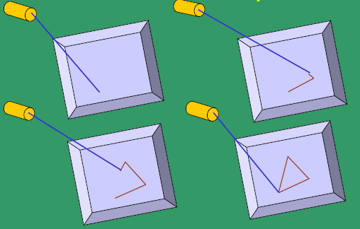

Slide 30

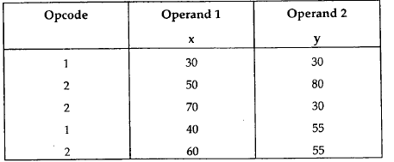
Display Buffer Structure
Stores commands necessary for drawing the line segments
Provides an interface between the image specification process and the image display process and the image display process
Display file command: opcode and operands
Store in three separate arrays :

Slide 31
Random-scan Displays
Advantages:
High resolution
Easy animation
Requires little memory
Disadvantages:
Requires intelligent electron beam (processor controlled)
Limited to simple, line-based images
Limited color capability.
Improved in the 1960’s by the Direct View Storage Tube (DVST) from Tektronix.

Slide 32
Random-scan Displays
Advantages:
High resolution
Easy animation
Requires little memory
Disadvantages:
Requires intelligent electron beam (processor controlled)
Limited to simple, line-based images
Limited color capability.
Improved in the 1960’s by the Direct View Storage Tube (DVST) from Tektronix.

Slide 33
Raster Scan vs. Random Scan
Raster Scan
In raster scan display the beam moves all over the screen - one scan line at a time, from top to bottom and then back to top
The pattern is created by illuminated spots.
produces jagged lines that are potted as discrete point sets.
Random Scan
In vector scan display the beam is moved between the end points of the graphics primitives
Here a picture is drawn one line at a time.
produces smooth line drawings as the CRT beam directly follows the line path.

Slide 34
Raster Scan vs. Random Scan
Raster Scan
The refresh process is independent of the complexity of the image
raster displays have less resolution.
Random Scan
Vector display flickers when the number of primitives in the buffer becomes too large.
random displays have high resolutions since the picture definition is stored as a set of line drawing commands and not as a set of intensity values.

Slide 35
Raster Scan
high degree realism is achieved in picture with the aid of advanced shading and hidden surface technique.
decreasing memory costs have made raster systems popular.
Has an ability to display areas filled with solid colors or patterns
Random Scan
realism is difficult to achieve.
random-scan system's are generally costlier.
Only draws lines and characters

Slide 36
Functions of Display Controller
Scan conversion : digitize a picture definition given in an application program into a set of pixel-intensity values
Generating various line styles
Display color areas
Performing certain transformations
Manipulations on display objects

Slide 37
Color CRT Monitor
Color CRT’s are designed as RGB monitors also called full-color system or true-color system.
Two techniques:
Shadow- mask technique: Used in raster scan displays
Beam-penetration technique: used in random scan displays

Slide 38
Shadow Mask
uses three phosphor color dots at each pixel position.
Red, Green and Blue
Uses 3 electron guns and a shadow-mask grid just behind the phosphor-coated screen
Use shadow-mask methods with intensity from each electron gun (red, green, blue) to produce any color directly on the screen without preprocessing.
Frame buffer contains 24 bits per pixel, for 256 voltage settings to adjust the intensity of each electron beam, thus producing a choice of up to 17 million colors for each pixel (256³).

Slide 39
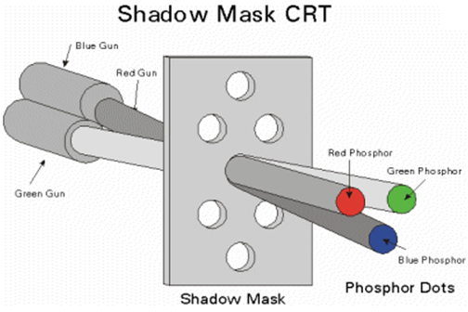
Color CRT Monitor…

Slide 40
Color CRT Monitor- Beam penetration
Beam penetration Technique:
Screen is coated with two layers of Phosphor: red and green
Displayed color depends on how far the electron beam penetrates into the phosphor layers
An expensive technique
Can display only four colors: red, green, orange and yellow
Poor quality of pictures produced

Slide 41
Direct-View Storage Tube (DVST)
Main problem with raster scan display
Need to refresh the image
Expensive solution
DVST uses alternate method of maintaining the screen image
Acts as high persistence CRT
Uses a special type of phosphor embedded in a storage tube that has a long lasting glowing effect
Uses storage grid : fine mesh wire grid made of very thin, high quality wire is located with a dielectric
stores the picture information as a charge distribution
Storage grid is placed behind phosphor coated screen
A pattern of positive charges is deposited on the grid and this pattern is transferred to the phosphor coated CRT by a continuous flood of electrons.
Notes:
It is similar to CRT as far as the electronic gun and phosphor coated mechanisms are concerned. But instead of the electron beam directly writing the pictures on the phosphor coated CRT screen, the writing is done with the help of fine-mesh wire grid. The grid made of very thin, high quality wire is located with a dielectric and is mounted just before the screen on the path of the electron beam from the gun. A pattern of positive charges is deposited on the grid and this pattern is transferred to the phosphor coated CRT by a continuous flood of electrons'. This flood of electrons' is produced by a "flood gun" (This is separate frame the electron gun that produces the main electron beam).

Slide 42
Contd…
Consists of two electron guns;
Primary gun
Flood gun
Primary gun: stores the picture pattern
Flood gun: maintains the picture display
Collector: smoothens out the flow of flood electrons

Slide 43
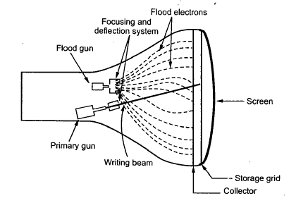
Contd…

Slide 44
Contd…
Advantages:
Refreshing of CRT is not required
Because no refreshing is required, very complex pictures can be displayed at very high resolution without flicker
Disadvantages:
They do not display colours and are available with single level of line intensity
Erasing requires removal of charge on the storage grid. Hence erasing and redrawing process takes several seconds
Selective or part erasing of screen is not possible
Erasing results unpleasant flash over the screen
Not suitable for dynamic graphics applications

Slide 45
Reading Assignment
Flat Panel displays
Plasma
LCD monitor

